Slide 1
ELECTRONIC DICE
InGenious project – Physics 3.A

Slide 2
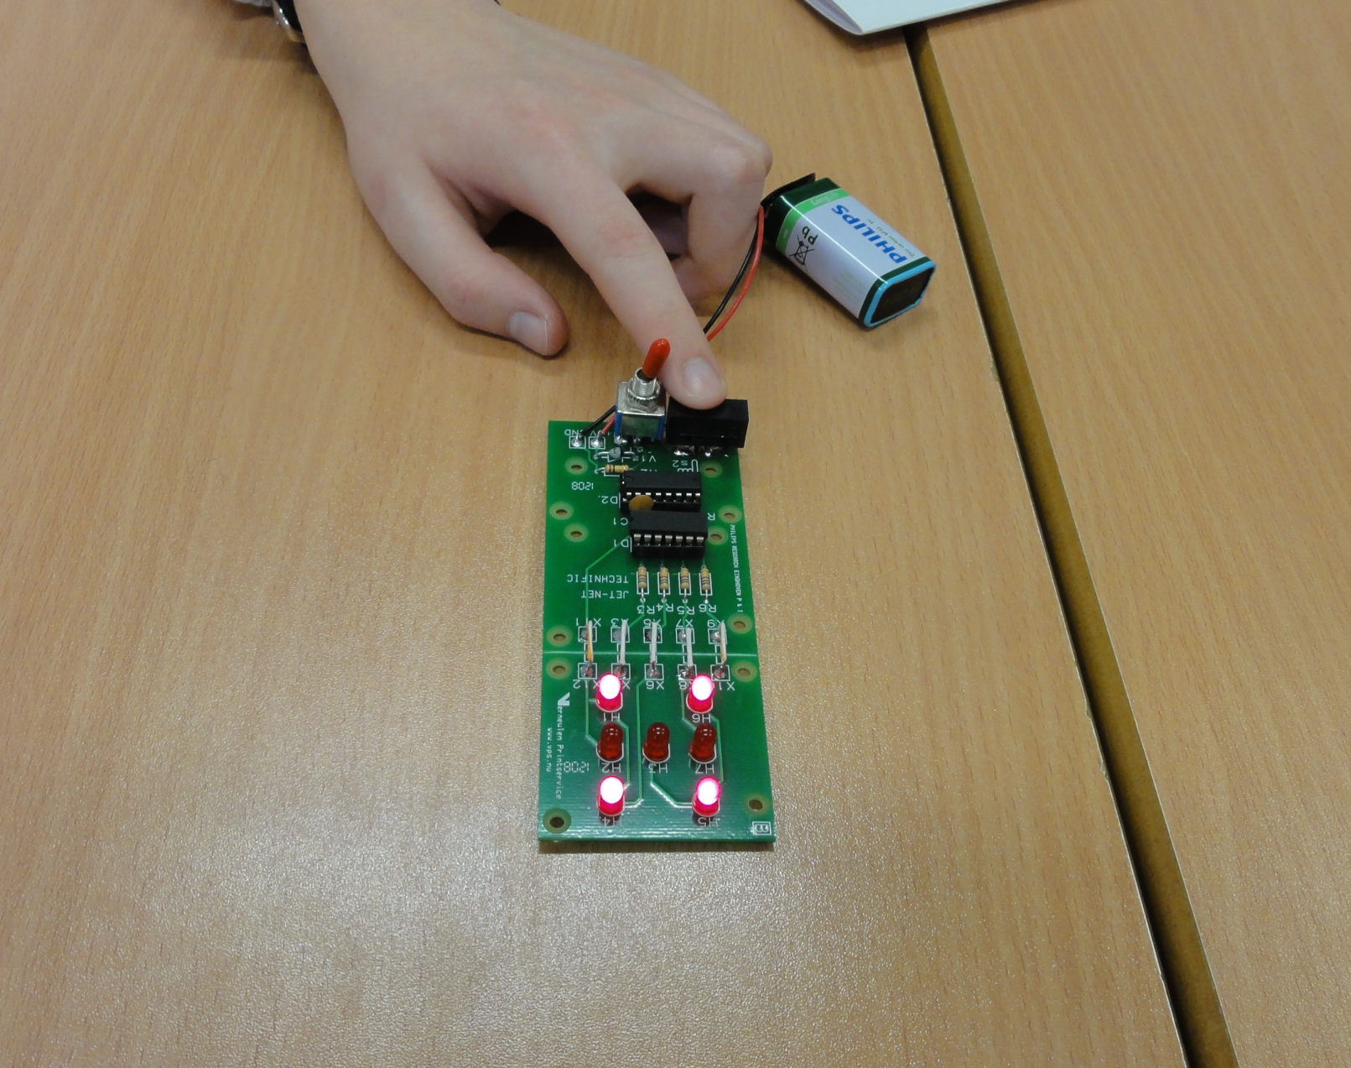

Slide 3
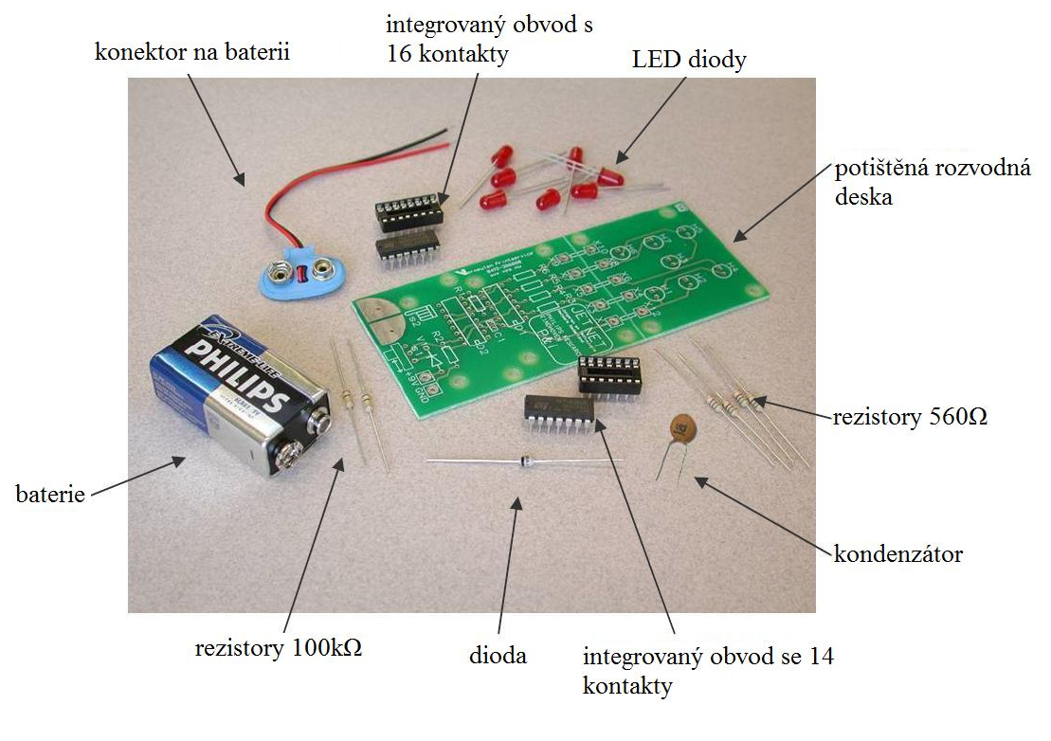
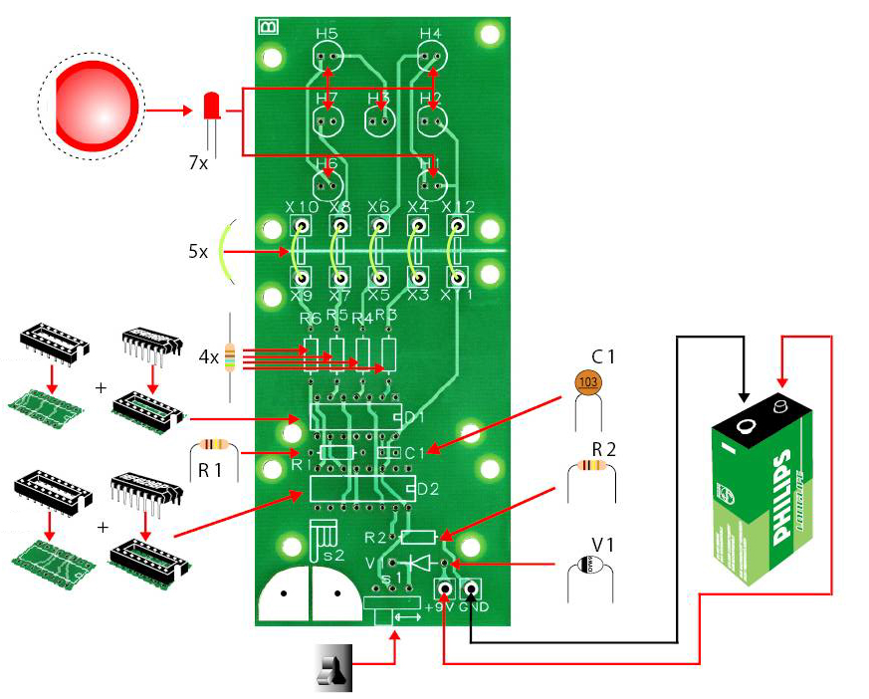
COMPONENTS

Slide 4
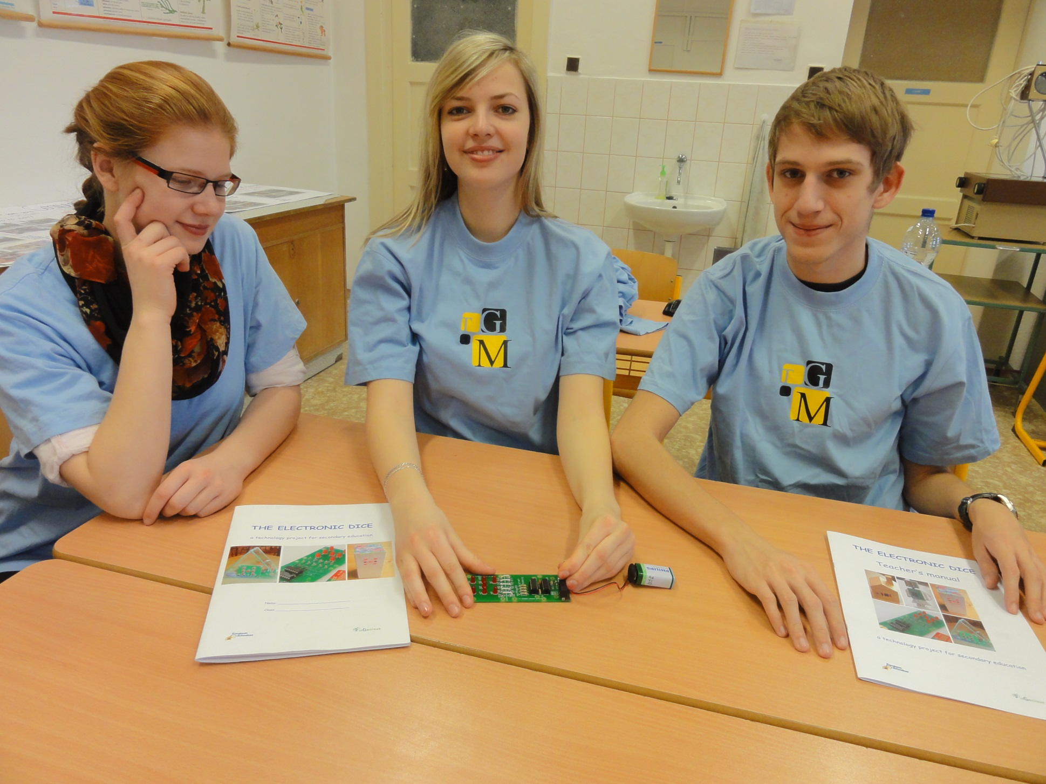
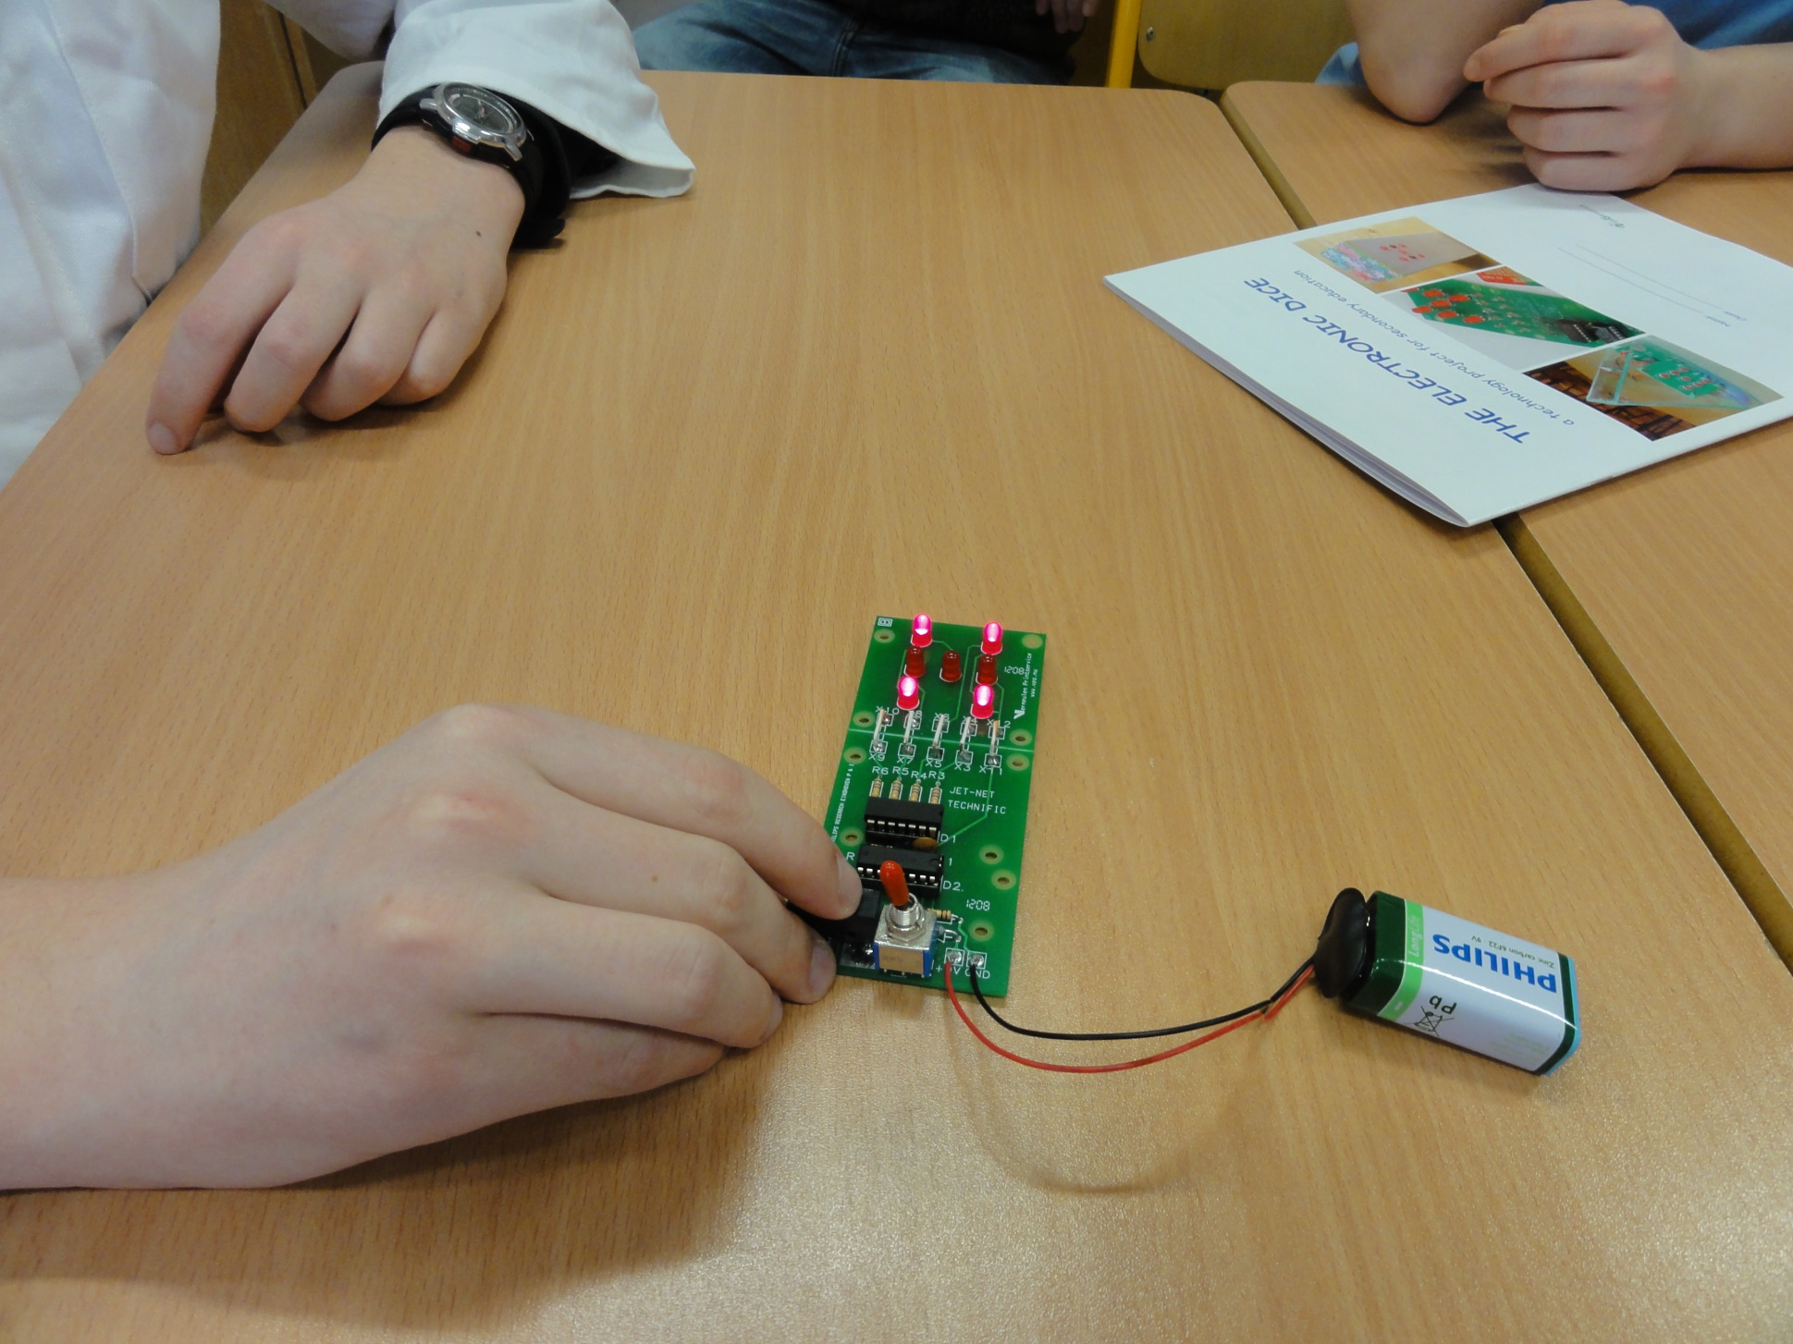
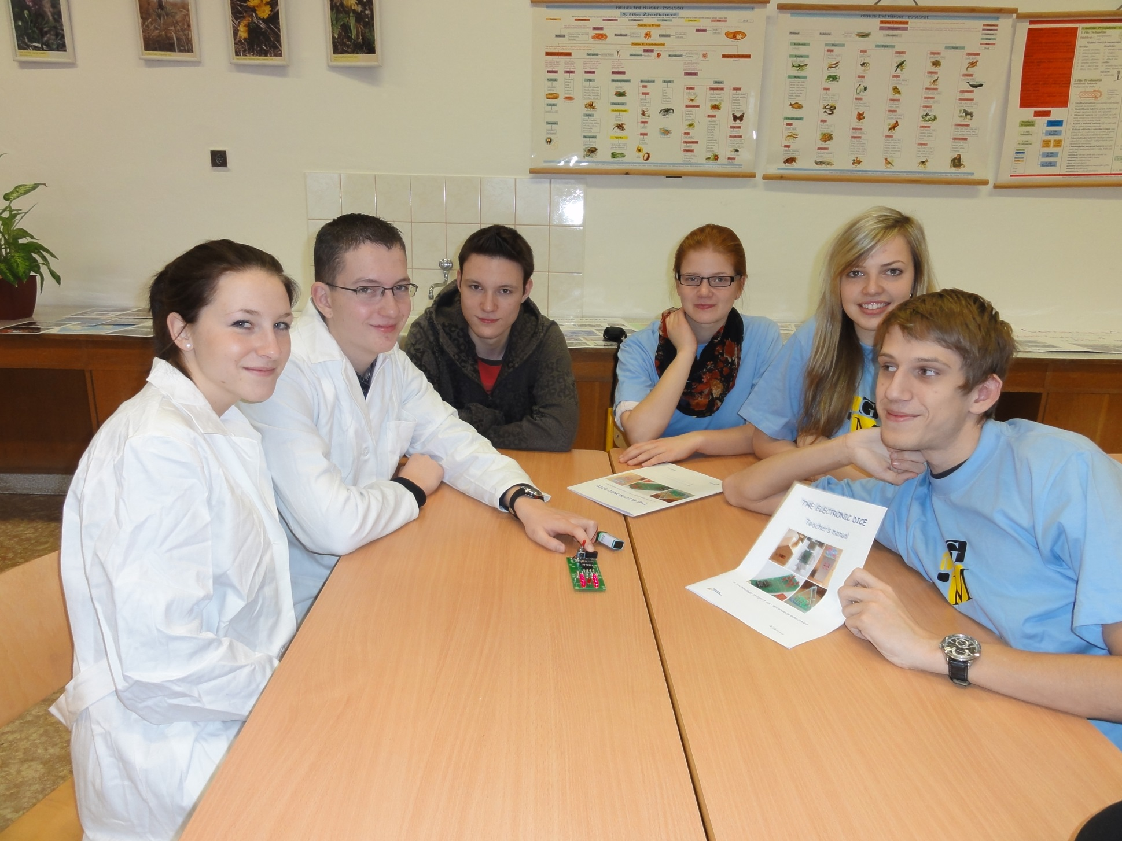

Slide 5
UTILIZATION
In playing board games like „Man, I‘m sorry!“ (Mensch ärgere Dich nicht)

Slide 6
ELECTRONIC DICE
InGenious project – Physics 3.A

